Slide 1

6th Grade Accelerated Math
Unit 13, Lesson 3 Applying Properties of Operations Volume 2, pg. 274

Slide 2


Benchmark
MA.6.AR.1.4
Apply the properties of operations to generate equivalent algebraic expressions with integer coefficients.
volume 2, pg. 274

Slide 3
Integrated Mathematical Thinking and Reasoning Standards
MA.K12.MTR.1.1 Actively participate in effortful learning both individually and collectively.
MA.K12.MTR.4.1 Engage in discussions that reflect on the mathematical thinking of self and others.
MA.K12.MTR.5.1 Use patterns and structure to help understand and connect mathematical concepts.
volume 2, pg. 274

Slide 4

Learning Target
I can apply the associative, commutative, and distributive properties to generate equivalent expressions.
volume 2, pg. 274

Slide 5

Warm-Up
volume 2, pg. 274

Slide 6
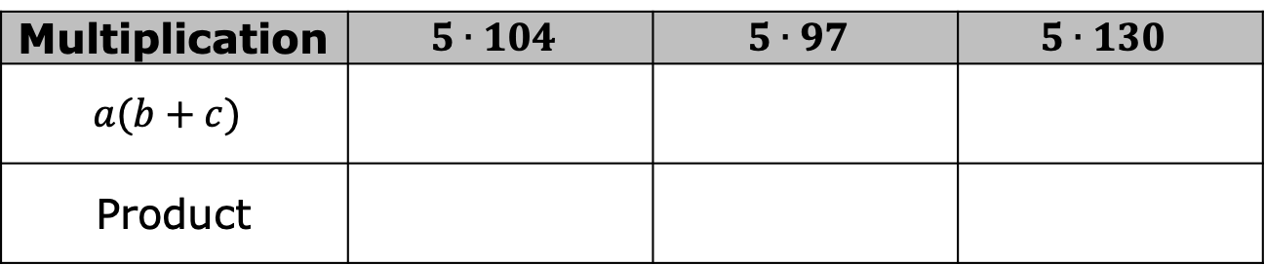
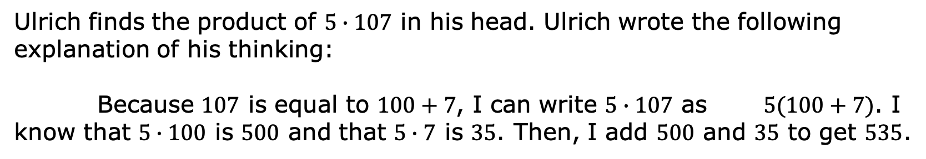
13.3.1 Warm-Up: Mental Math
Ulrich finds the product of $5∙107$ in his head. Ulrich wrote the following explanation of his thinking:
Because $107$ is equal to $100+7$, I can write $5∙107$ as $5(100+7)$. I know that $5∙100$ is $500$ and that $5∙7$ is $35$. Then, I add $500$ and $35$ to get $535$.
Use Ulrich’s reasoning to write each in the form $a(b+c)$. Then, use that form to find the product.
Multiplication | $$5∙104$$ | $$5∙97$$ | $$5∙130$$
$$a(b+c)$$
Product
volume 2, pg. 274

Slide 7

Exploration
volume 2, pg. 275

Slide 8

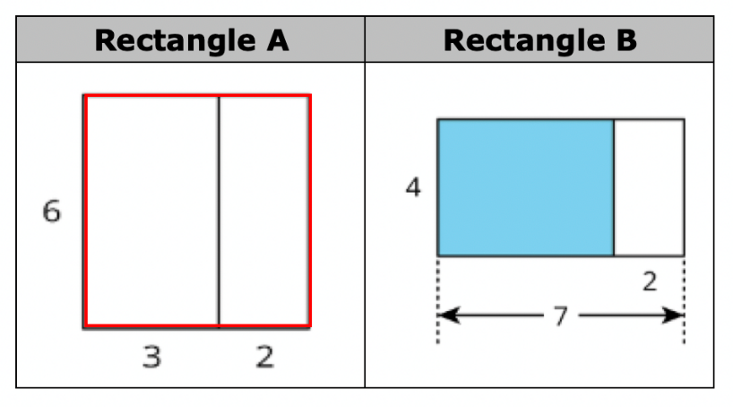
13.3.2 Exploration: Representing Area of a Rectangle
Work with your partner to answer the questions.
volume 2, pg. 275

Slide 9

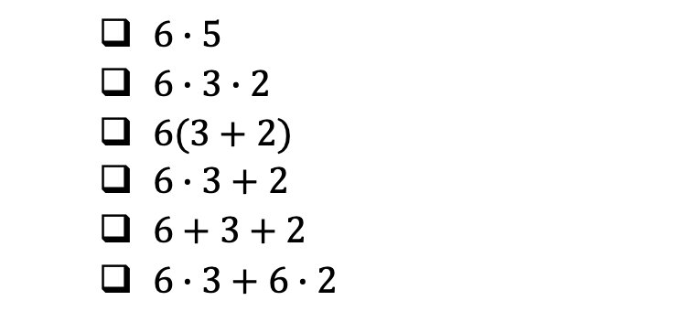
Rectangle A is divided into two smaller rectangles. Select all the expressions that could be used to determine the area of Rectangle A.
With your partner, discuss which expressions are in the form $a(b+c)$.
$6∙5$
$6∙3∙2$
$6(3+2)$
$6∙3+2$
$6+3+2$
$6∙3+6∙2$
volume 2, pg. 275

Slide 10

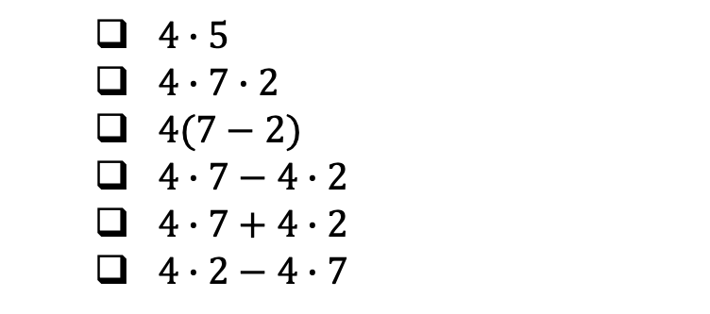
Rectangle B is divided into two smaller rectangles. Select all the expressions that could be used to determine the area of the blue rectangle inside Rectangle B.
With your partner, discuss which expressions are in the form $a(b+c)$.
$4∙5$
$4∙7∙2$
$4(7−2)$
$4∙7−4∙2$
$4∙7+4∙2$
$4∙2−4∙7$
volume 2, pg. 275

Slide 11
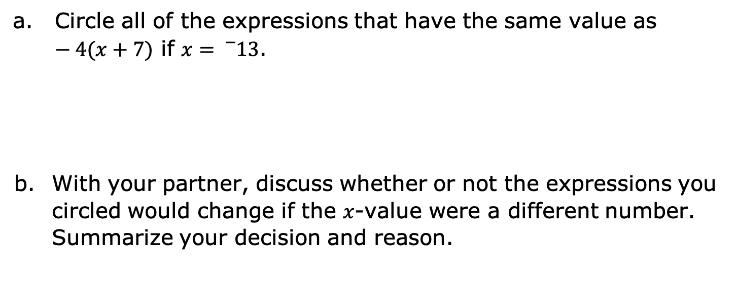
Complete the following problems.
Circle all of the expressions that have the same value as $−4(x+7)$ if $x={}_{}^{−}{13}$.
With your partner, discuss whether or not the expressions you circled would change if the $x$-value were a different number. Summarize your decision and reason.
$$−4x+7$$ | $$(x+7)∙−4$$ | $$−4x+−4∙7$$ | $$4(x−7)$$ | $${}_{}^{−}{28}−4x$$
volume 2, pg. 276
Notes:
\[]
‘p

Slide 12

Guided Instruction
volume 2, pg. 276

Slide 13
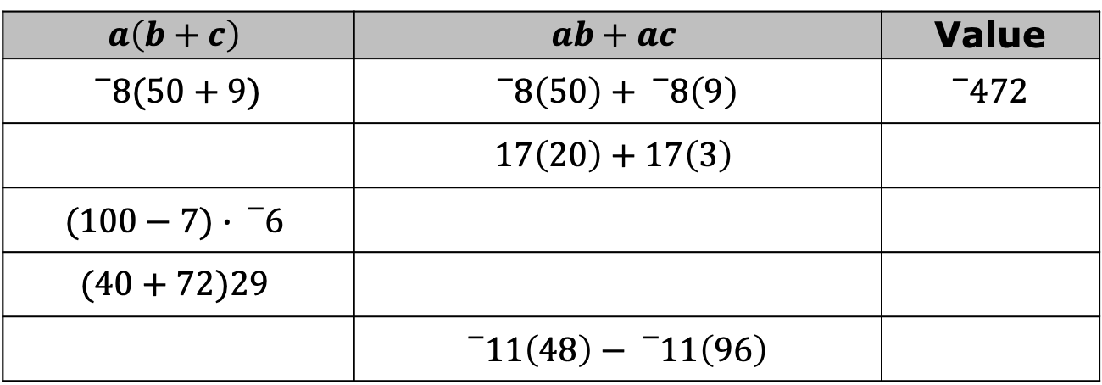
13.3.3 Guided Instruction: Applying Properties of Operations
The distributive property of multiplication over addition is a property that applies to all rational numbers. The distributive property “distributes” a factor to all terms within a set of parentheses.
Complete the table. The first row has been completed.
$$a\left(b+c\right)$$ | $$ab+ac$$ | Value
$${}_{}^{−}{8(50+9)}$$ | $${}_{}^{−}8\left(50\right)+{}_{}^{−}8\left(9\right)$$ | $${}_{}^{−}{472}$$
 | $$17\left(20\right)+17\left(3\right)$$
$$(100−7)∙{}_{}^{−}6$$
$$(40+72)29$$
 | $${}_{}^{−}{11}\left(48\right)−{}_{}^{−}{11}\left(96\right)$$
volume 2, pg. 276

Slide 14
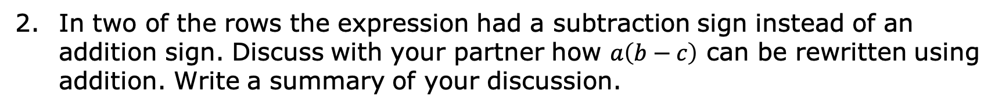
In two of the rows the expression had a subtraction sign instead of an addition sign. Discuss with your partner how $a\left(b−c\right)$ can be rewritten using addition. Write a summary of your discussion.
volume 2, pg. 276

Slide 15
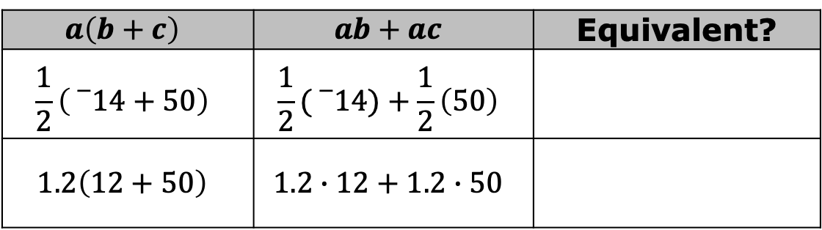
Use the expressions below to show that the distributive property of multiplication over addition works with rational numbers.
$$a\left(b+c\right)$$ | $$ab+ac$$ | Equivalent?
$$\frac{1}{2}\left({}_{}^{−}{14+50}\right)$$ | $$\frac{1}{2}({}_{}^{−}{14)+\frac{1}{2}\left(50\right)}$$
$$1.2\left(12+50\right)$$ | $$1.2∙12+1.2∙50$$
Mathematicians determine a property exists when expressions are equivalent, no matter what number is used. A property can then be used with variables.
Expressions are equivalent if they have the same value, no matter what number is substituted in for each of the variables.
volume 2, pg. 277

Slide 16
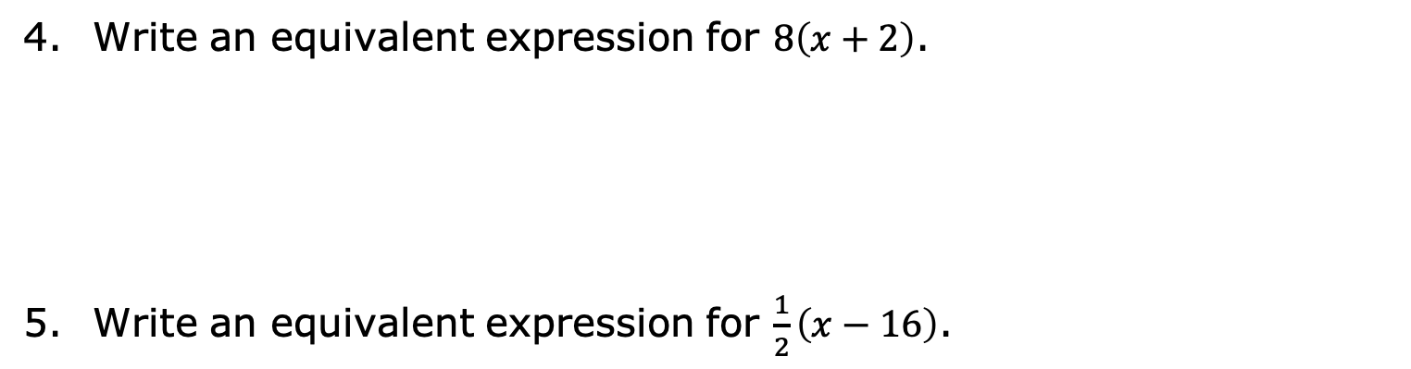
Write an equivalent expression for $8\left(x+2\right)$.
Write an equivalent expression for $\frac{1}{2}\left(x−16\right)$.
volume 2, pg. 277

Slide 17
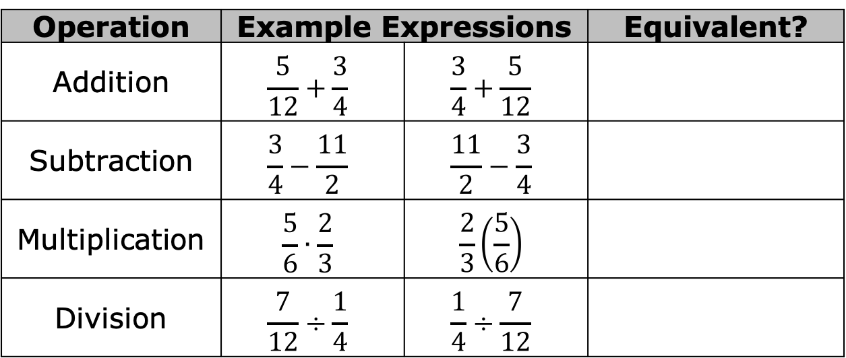
The commutative property states that the order in which an operation is performed does not change the value of the expression.
Use the pairs of expressions below to determine the operations for which the commutative property is true.
Operation | Example Expressions |  | Equivalent?
Addition | $$\frac{5}{12}+\frac{3}{4}$$ | $$\frac{3}{4}+\frac{5}{12}$$
Subtraction | $$\frac{3}{4}−\frac{11}{2}$$ | $$\frac{11}{2}−\frac{3}{4}$$
Multiplication | $$\frac{5}{6}∙\frac{2}{3}$$ | $$\frac{2}{3}\left(\frac{5}{6}\right)$$
Division | $$\frac{7}{12}÷\frac{1}{4}$$ | $$\frac{1}{4}÷\frac{7}{12}$$
The commutative property only applies to ____ and ____.
volume 2, pg. 277

Slide 18

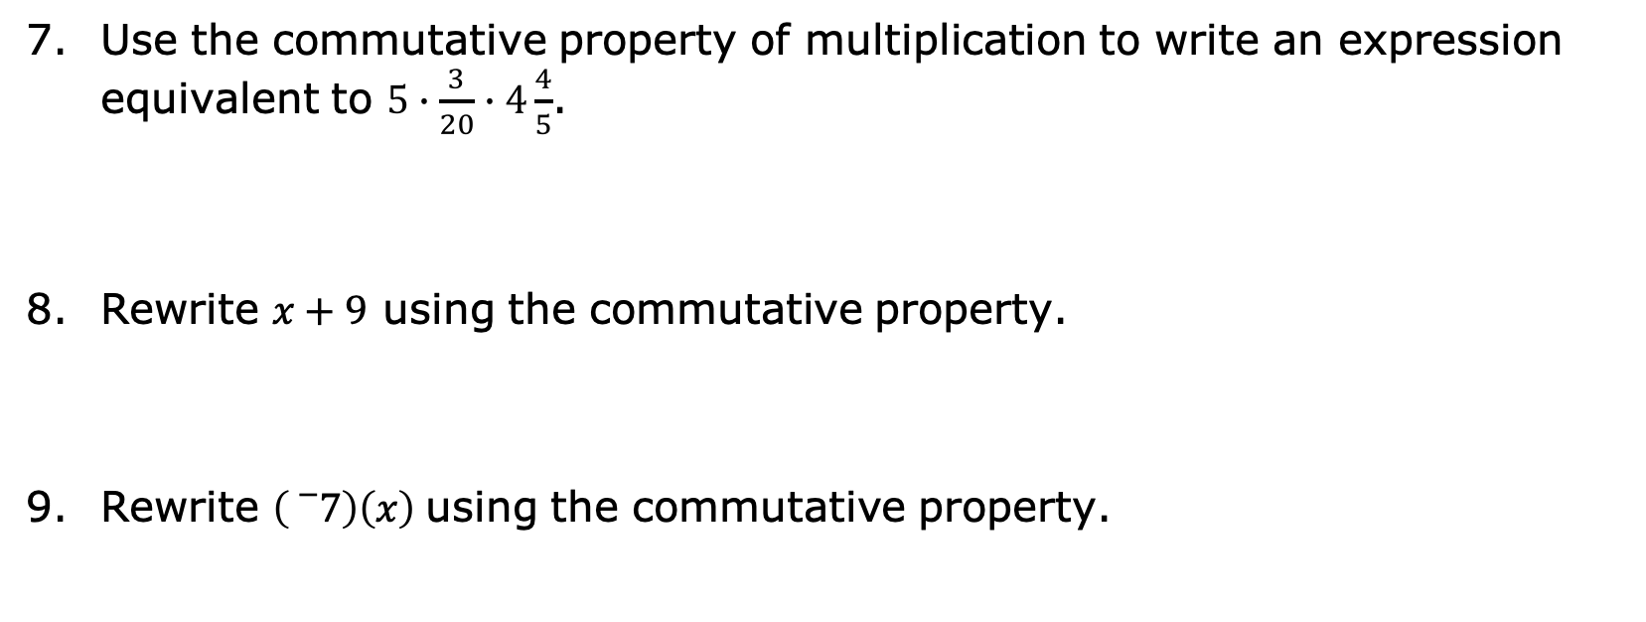
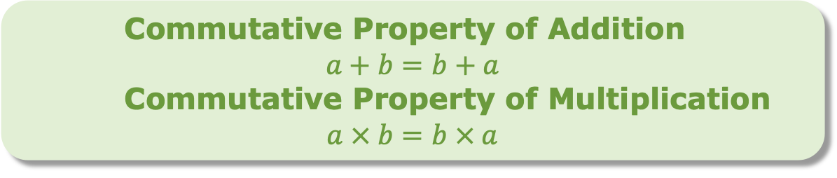
Use the commutative property of multiplication to write an expression equivalent to $5∙\frac{3}{20}∙4\frac{4}{5}$.
Rewrite $x+9$ using the commutative property.
Rewrite $\left({}_{}^{−}7\right)\left(x\right)$using the commutative property.
Commutative Property of Addition
$$a+b=b+a$$
Commutative Property of Multiplication
$$a × b=b × a$$
volume 2, pg. 278

Slide 19
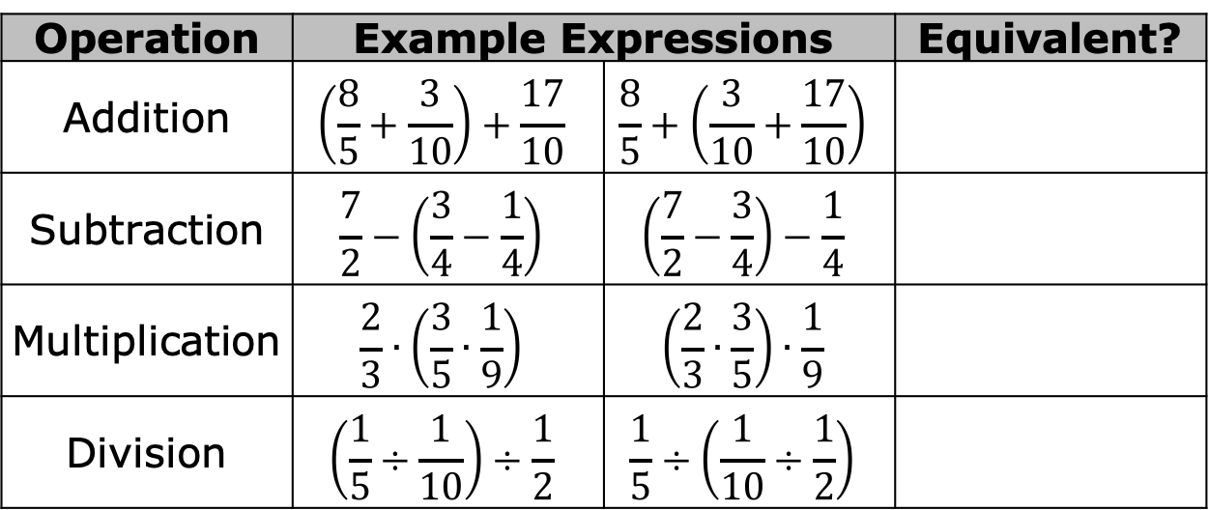
The associative property states that the way in which numbers are grouped does not change the value of the expression.
Use the pairs of expressions below to determine the operations for which the associative property is true.
Operation | Example Expressions |  | Equivalent?
Addition | $$\left(\frac{8}{5}+\frac{3}{10}\right)+\frac{17}{10}$$ | $$\frac{8}{5}+\left(\frac{3}{10}+\frac{17}{10}\right)$$
Subtraction | $$\frac{7}{2}−\left(\frac{3}{4}−\frac{1}{4}\right)$$ | $$\left(\frac{7}{2}−\frac{3}{4}\right)−\frac{1}{4}$$
Multiplication | $$\frac{2}{3}∙\left(\frac{3}{5}∙\frac{1}{9}\right)$$ | $$\left(\frac{2}{3}∙\frac{3}{5}\right)∙\frac{1}{9}$$
Division | $$\left(\frac{1}{5}÷\frac{1}{10}\right)÷\frac{1}{2}$$ | $$\frac{1}{5}÷\left(\frac{1}{10}÷\frac{1}{2}\right)$$
The associative property only applies to ____________ and ______________.
volume 2, pg. 278

Slide 20
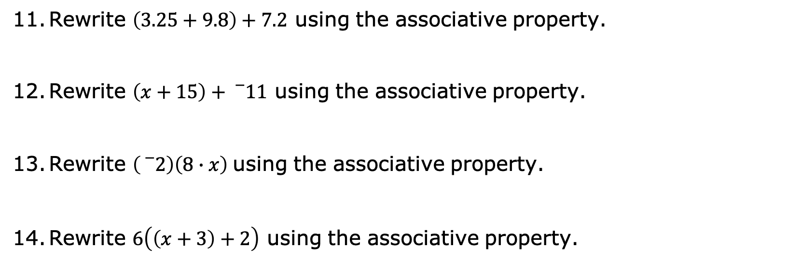
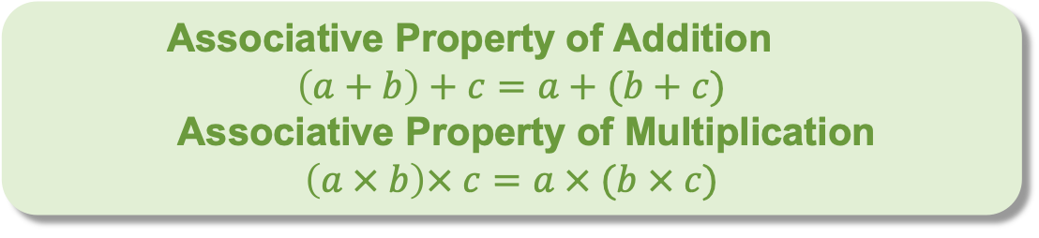
Rewrite $\left(3.25+9.8\right)+7.2$ using the associative property.
Rewrite $\left(x+15\right)+{}_{}^{−}{11}$ using the associative property.
Rewrite $\left({}_{}^{−}2\right)\left(8∙x\right)$using the associative property.
Rewrite $6\left(\left(x+3\right)+2\right)$ using the associative property.
Associative Property of Addition
$$\left(a+b\right)+c=a+(b+c)$$
Associative Property of Multiplication
$$\left(a × b\right)× c=a × (b × c)$$
volume 2, pg. 279

Slide 21

Wrap-Up
volume 2, pg. 279

Slide 22
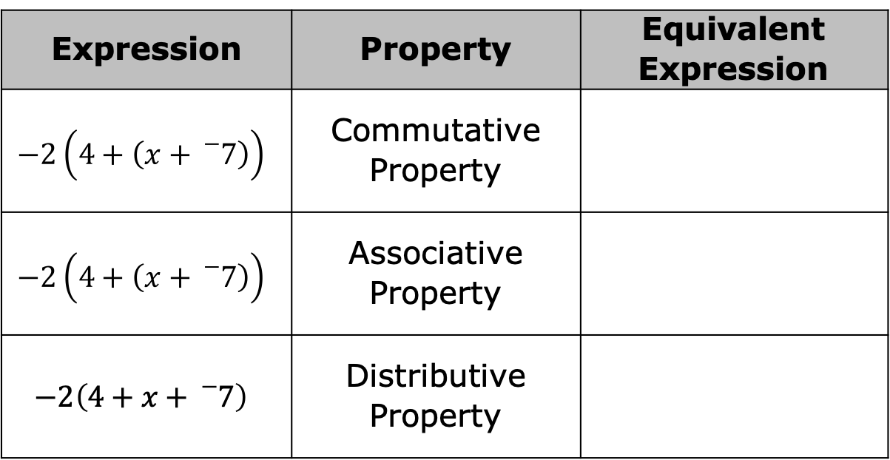
13.3.4 Wrap-Up: Ticket Out the Door
Write an equivalent expression that uses each given property to complete the table.
Expression | Property | Equivalent Expression
$$−2\left(4+\left(x+{}_{}^{−}7\right)\right)$$ | Commutative Property
$$−2\left(4+\left(x+{}_{}^{−}7\right)\right)$$ | Associative Property
$$−2\left(4+x+{}_{}^{−}7\right)$$ | Distributive Property
volume 2, pg. 279

